Slide 1
MINI PROJECT ON IT Office employees record system
SUBMITTED BY:-
Suneet Yadav
MCA -3rd Semester

Slide 2
INDEX
Objective
Methodology
Data Flow Diagram
Implementation and Result.
Future Scope
System Requirements
Conclusion

Slide 3
Submitted To Department of Computer Application
In a partial fulfilment of the requirements for the degree of Masters of Computer Application.
Under the supervision of –
Mr.Pankaj Sir

Slide 4
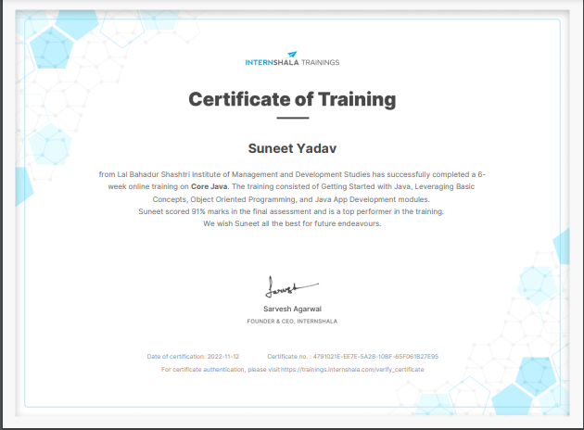

Slide 5
Objectives
The objective of this work is to give a complete approach to personnel information management. This will be accomplished by developing and deploying an HR management system that will result in a significant shift in the way employee data is managed.
This system's objectives include the following:
Design of an HR management system to meet needs such as adding and deleting employees, viewing and printing employee data, and updating employee information.
Employee data is stored in a well-designed database.
An easy-to-use interface that will let user interact with the system.

Slide 6
Methodology
The methodology to complete this project is as follows:
I explored net beans, concepts of swings and applets.
For further and a deeper understanding, I even referred to some articles, books, journals, websites and news articles.
Some important concepts of my project.
Net Beans
Java
Swing
SQL(structured query language)

Slide 7
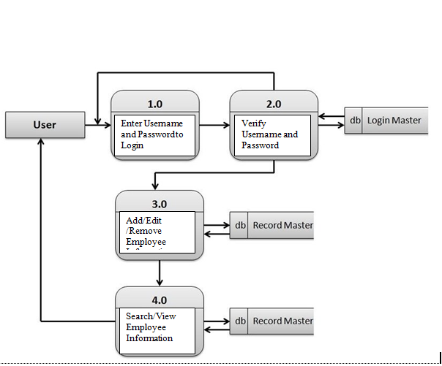
Data Flow Diagram

Slide 8
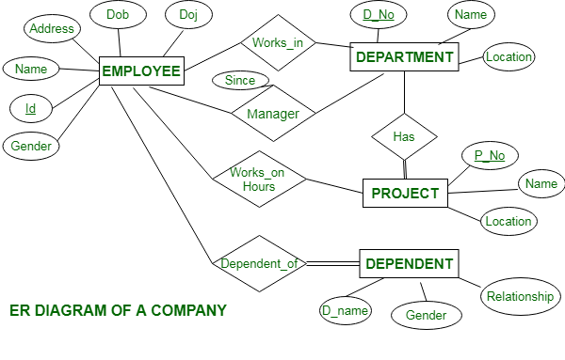
E-R Diagram

Slide 9
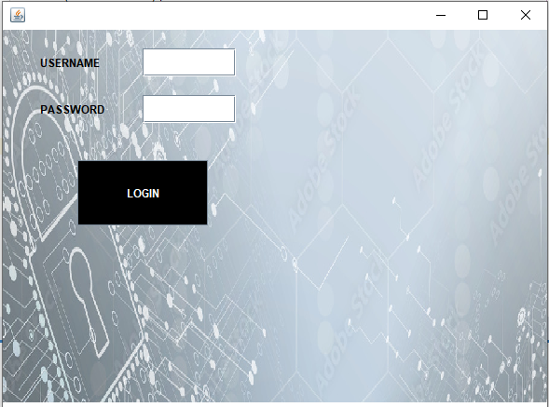
Implementation and Result
Following are the screens of the Employee Management System where you can see all the features of this system in use and you can also see the GUI of the system:
1).Login frame – This is the login frame of this system where user have to enter the required credentials to have access for the main dashboard.

Slide 10
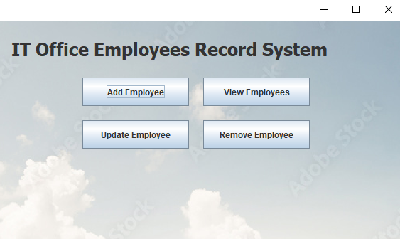
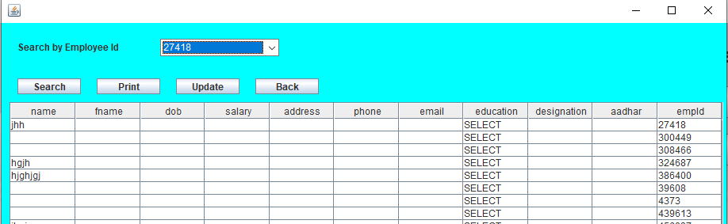
2). Main Dashboard – After login in, user is directed to the main dashboard of this system where user can perform various operations like adding an employee, deleting an employee.
3). View and update employee – In order to view and update employee information, the user have to enter employee ID.

Slide 11
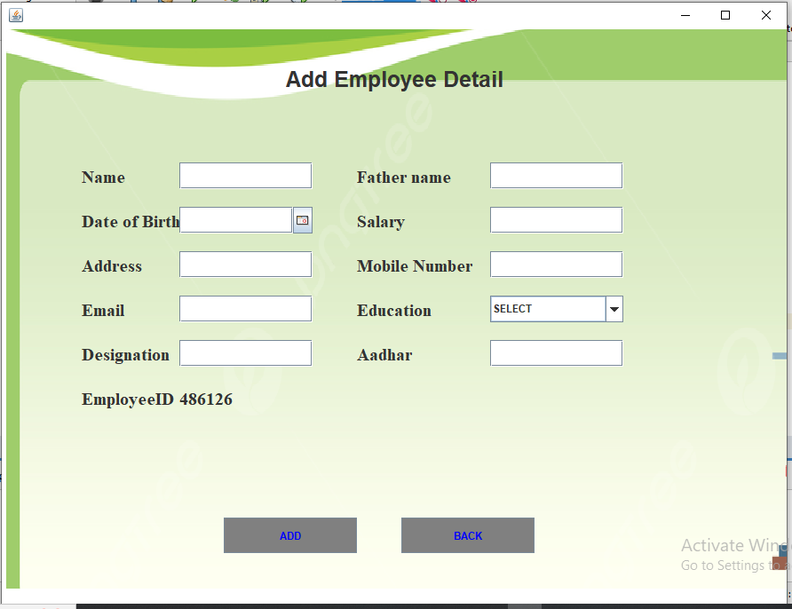
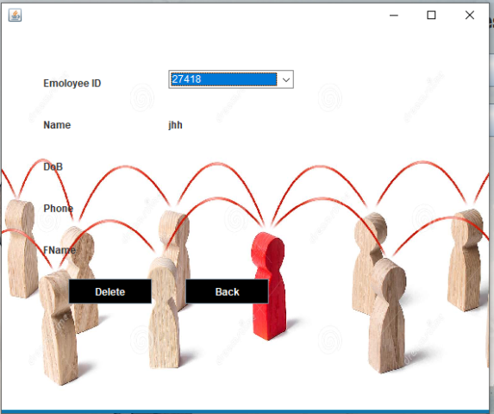
4).Add employee – Here user have to enter all the required credentials to add a new employee to the system.
5) Remove employee – User has to enter the employee id in order to delete his information from the system.

Slide 12
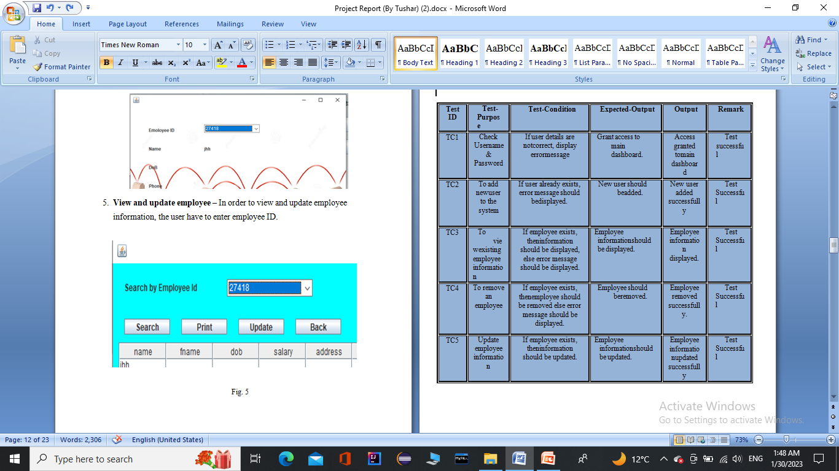
Testing

Slide 13
Future Scope
The GUI and the features added to this system are the basic ones. In future, there will be a better Graphical User Interface and there will be more features added to this system. If Graphical User Interface is improved then this system will be more user friendly and more features added will make this system a lot better and HR will be able to perform more operations

Slide 14
System Requirements Software Require
For Creating IT Office Employees Record System IDE is required for coding and run GUI based application.
I have use Apache Net Beans IDE 13 and for Database use MYSQL.
Hardware Required
A Personal Computer A system with at least Pentium dual core processor, 4GB RAM and 128 GB storage.

Slide 15
Modules
Splash.java-Start page
Login.java-Login page
Cone.java-MYSQL connection
Home.java-Home Page
AddEmployee.java-For adding employees
ViewEmployee.java-For view details
UpdateEmployee.java-For update information
RemoveEmployee.java-For removing employee

Slide 16
Conclusion
The goal of the initiative is to digitize personnel databases in businesses and provide administrators access to computers. Employees and administrators use software as an information system. The user can store his or her database safe and secure for an indefinite amount of time here. Adding, deleting, accessing, and changing employee information is simple and easy using the Employee Management System.

